Slide 1
Data Structures Capstone
Nick Farmer

Slide 2
Data Structure Choice for Part 1
I chose a Trie structure mainly because it was supposed to be the most challenging and worth the most points. A little searching on the old interwebs turned up a few different options for Trie code--I adapted from a couple examples to produce one that would do what I needed it to do.
Happily, even though it was a new structure, because it did what I needed it to do so well, it actually ended up being easier than if I’d tried another strategy.

Slide 3
Tries are A-O(k) 👌
Another advantage of the Trie, even in a limited case like this, is that the Big-O runtime for this structure is O(k) where k is the length of the key. Better than a Linked List’s O(n) where n is the length of the list, and by extension the HashMap of Linked Lists. This would be even more pronounced with very long lists, of course.

Slide 4
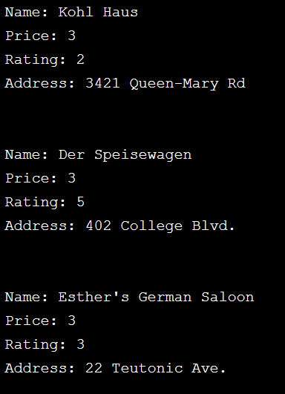
Data Structure Choice for Part 2
To be honest, the main reason I went for the HashMap-LL-HashMap structure was because it would lead to a better UI, where I could use the key-value pairs to format the strings to print out nicely. If I’d gone with Linked Lists all the way, it would have printed without any formatting, thus making it unreadable. You wouldn’t be able to tell the difference between “Price” and “Rating.”

Slide 5
Runtime for Restaurant Retrieval
Using a HashMap for retrieving the list of restaurants is just O(1). Retrieving the actual list is O(n), and then another O(1) for the HashMaps for each piece of information about each restaurant. Add it all together and round it, and you get O(n). Not bad.

Slide 6
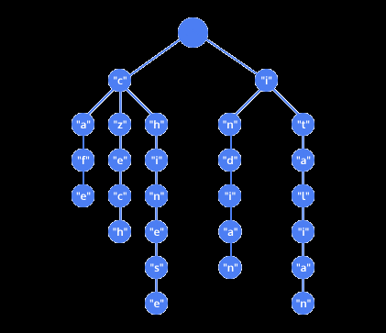

Other Ways to Use Data Structures
Tries make excellent nursery mobiles for the programmers of the future.
Feel free to use my joke, but give me credit. © Nick Farmer

Slide 7
But in all seriousness...
For every purpose, there is an appropriate data structure, and as Moore’s Law continues to fade into myth and legend and we can’t rely on ever-growing processing power to make up for slow runtimes, familiarity with how data are stored and accessed will only grow in importance.
I’m not sure how innovative I can claim to be regarding new and exciting uses of different data structures, but I think that’s OK. There’s a lot of low hanging fruit. So much can be accomplished with optimizing what is already out there by using the right data structure.

